Slide 1
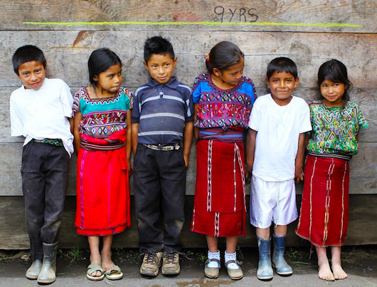
Is temperature have any influence on Sever Stunting?
Atanu Chanda
Global Alliance of Improved Nutrition

Slide 2
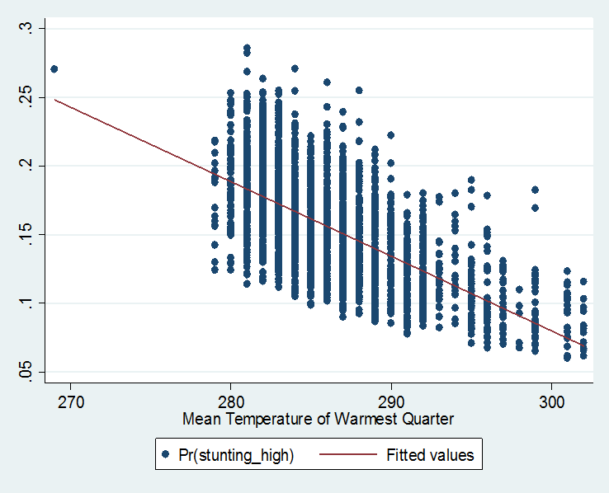
*Percentage of children, aged 0 to 59 months, whose height for age is below minus three standard deviations (severe stunting) from the median of the WHO Child Growth Standards.

Slide 3
